Slide 1
Parallel and Distributed Computing Overview (CS 3006)
Muhammad Aadil Ur Rehman
Department of Computer Science,
National University of Computer & Emerging Sciences, Islamabad Campus
Credits: Dr. Muhammad Aleem

Slide 2
Collective Communications
Processes may need to communicate with everyone else
Three Main Classes:
Communications: Broadcast, Gather, Scatter
Synchronization: Barriers
Reductions: sum, max, etc.
Properties:
Must be executed by all processes (of the communicator)
All processes in group call same operation at (roughly) the same time
All collective operations are blocking operations

Slide 3
Broadcast
A one-to-many communication
before bcast
r
e
d
after bcast
r
e
d
r
e
d
r
e
d
r
e
d
r
e
d
e.g., root=1
rank of the sending process (i.e., root process)
must be given identically by all processes

Slide 4
Broadcasting with MPI_Bcast
The contents of the send buffer is copied from a sender (i.e., root process) to all other processes, (including itself)
The type signature (number of elements, data type) on any process must be same (as on the root process)

Slide 5
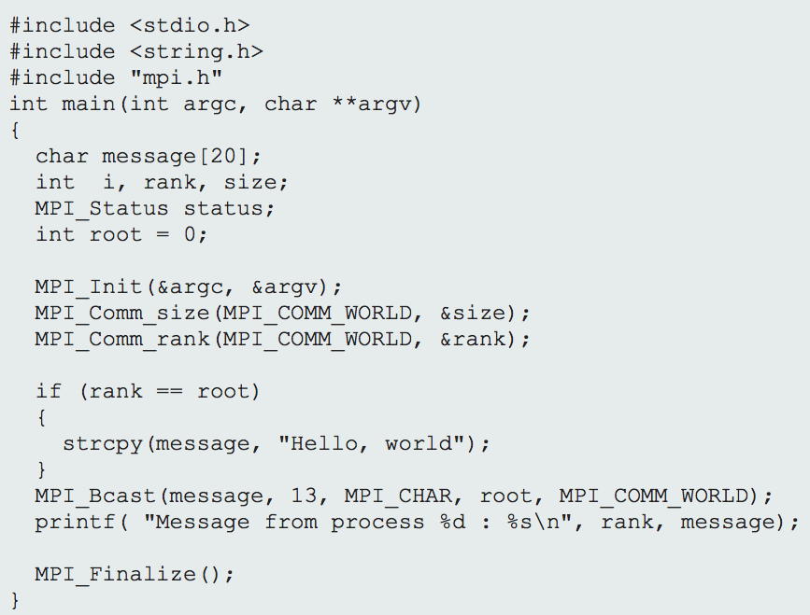
Broadcasting with MPI_Bcast
Demo: BroadCast.c

Slide 6
MPI_Scatter
MPI_Scatter is a collective routine that is similar to MPI_Bcast
It sends chunks of an array to different processes

Slide 7
MPI_Scatter
The root sends a part of its send buffer to each process
• Process k receives sendcount elements starting with sendbuf+k*sendcount

Slide 8
MPI_Scatter - Example
Demo: Scatter.c

Slide 9
MPI_Gather
MPI_Gather is the inverse of MPI_Scatter
It takes elements from many processes and gathers them to one single process

Slide 10
MPI_Gather

Slide 11
MPI_Gather

Slide 12
MPI_Gather
The root receives data from all processes (from send buffers)
It stores the data in the receive buffer ordered by the process number of the senders

Slide 13
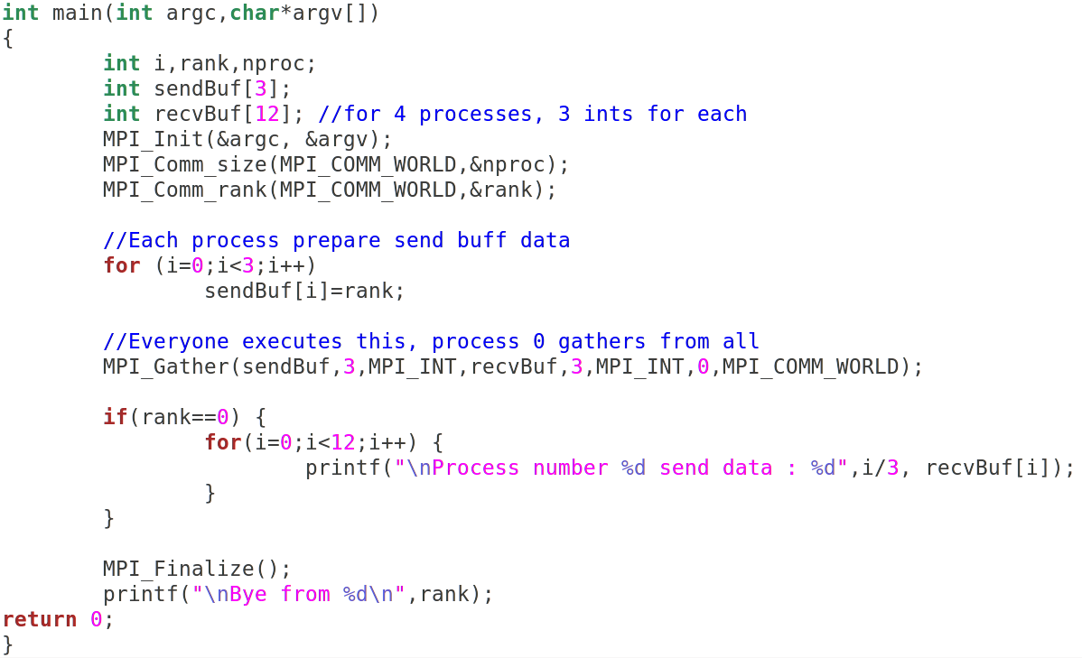
MPI_Gather - Example
Demo: Gather.c

Slide 14
MPI_Scatterv
MPI_Scatterv is a collective routine that is similar to MPI_Scatter
It sends variable chunks of an array to different processes
Process-0
Process-1
Process-2
Process-3
Credits: https://www.cineca.it/

Slide 15
MPI_Scatterv
Demo: ScatterV.c
sendbuf: address of send buffer (significant only at root)
sendcounts: integer array (of length group size) specifying the number of elements to send to each processor
displs: integer array (of length group size). Entry i specifies the displacement (relative to sendbuf from which to take the outgoing data to process i
sendtype: data-type of send buffer elements
recvcount: number of elements in receive buffer (integer)
recvtype: data-type of receive buffer elements
root: rank of sending process (integer)
comm: communicator (handle)

Slide 16
MPI_Gatherv
Different number of elements can be received by the root process
Individual messages are stored according to displs in the receive buffer
Credits: https://www.cineca.it/

Slide 17
MPI_Gatherv

Slide 18
MPI_Gatherv
Demo: GatherV.c
sendbuf: address of send buffer
sendcounts: number of elements in send buffer (integer)
sendtype: data-type of send buffer elements
recvbuf: address of the receive buff (significant at root)
recvcounts: integer array (of length group size) containing the number of elements that are to be received from each process (on root)
displs: integer array (of length group size). Entry i specifies the displacement relative to recvbuf at which to place data from process i (significant only at root)
recvtype: data-type of receive buffer elements (handle)
root: rank of receiving process (root)
comm: communicator (handle)

Slide 19
Home Tasks
MPI_Allgather
Similar to MPI_Gather, but the result is available to all processes
MPI_Allgatherv
Similar to MPI_Gatherv, but the result is available to all processes
MPI_Alltoall
Similar to MPI_Allgather, each process performs a scater followed by gather process
MPI_Alltoallv
Similar to MPI_Alltoall, but messages to different processes can have different length

Slide 20
MPI_Alltoall
MPI_Alltoall makes a redistribution of contents such that
each process know the buffer of all others. It is a way to implement the matrix data transposition

Slide 21
Synchronization

Slide 22
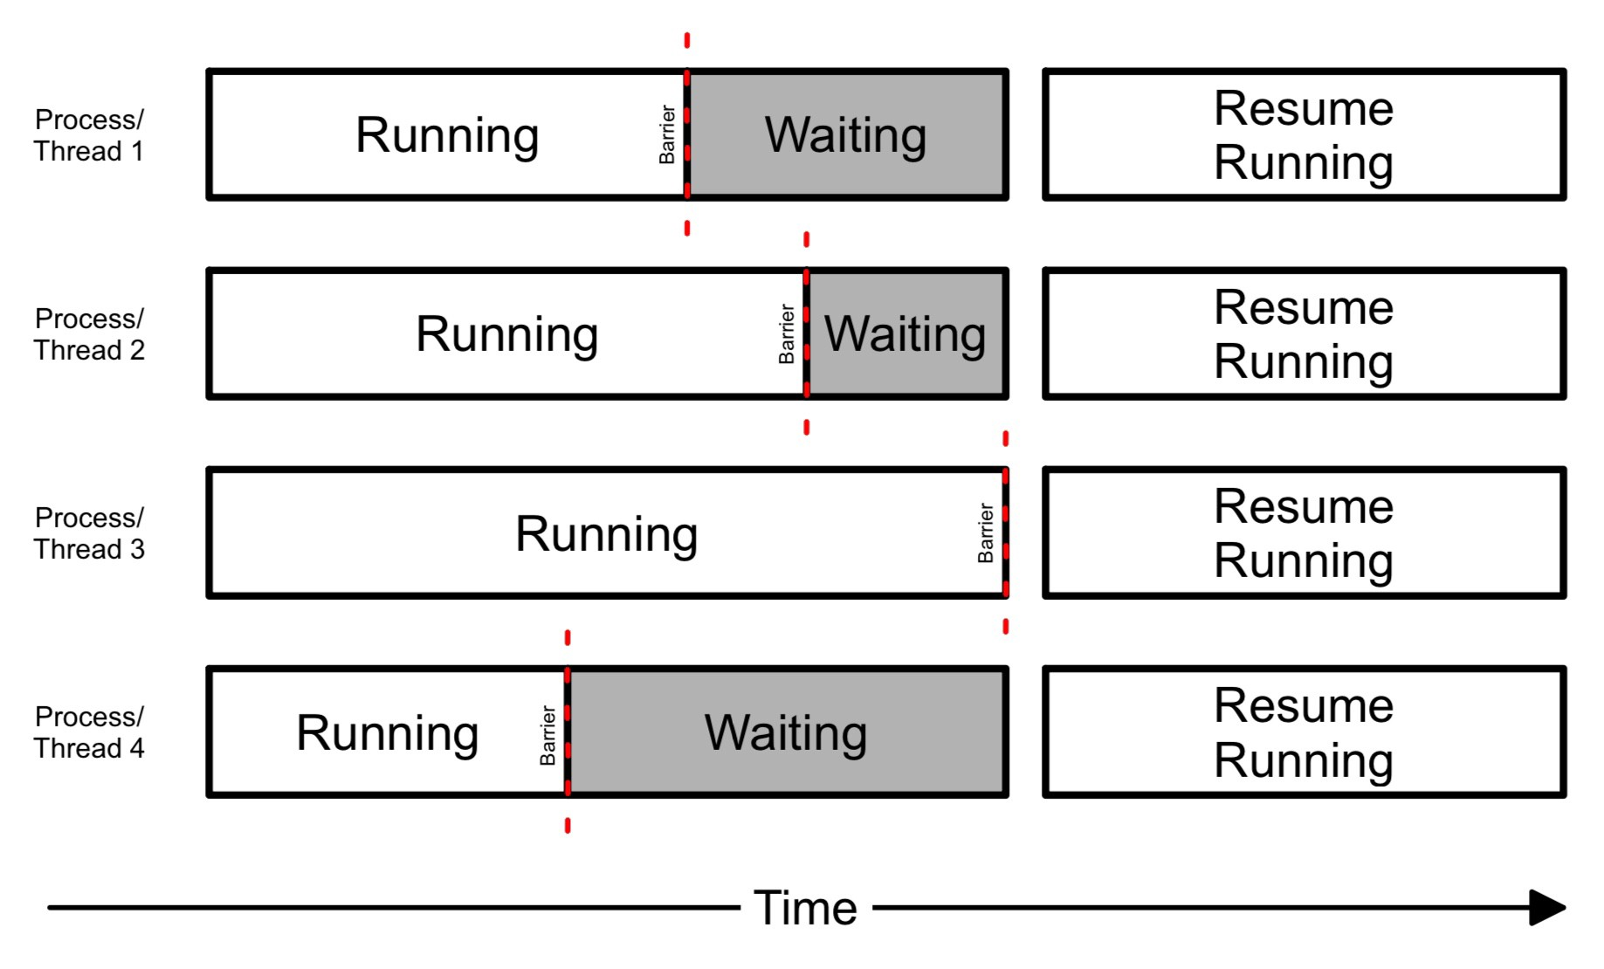
Barrier Synchronization
Credits: https://medium.com/@jaydesai36/barrier-synchronization-in-threads-3c56f947047
Notes:
MPI_Barrier can be useful for many things. One of the primary uses of MPI_Barrier is to synchronize a program so that portions of the parallel code can be timed accurately.

Slide 23
MPI_BARRIER
It synchronizes all processes (by blocking the Processes) in communicator until all processes have called MPI_Barrier.
Notes:
https://cvw.cac.cornell.edu/MPIcc/barrier

Slide 24
Reductions

Slide 25
Reductions
The communicated data of the processes are combined via a specified operation, e.g. ’+’
Two different variants:
Result is only available at the root process
Result is available at all processes
Input values (at each process):
- Scalar variable: operation combines all values of the
processes
– Array: The elements of the arrays are combined in an
element-wise fashion. The result is an array.

Slide 26
MPI_Reduce
This operation combines the elements in the send buffer
and delivers the result to root.
• Count, op, and root have to be equal in all processes

Slide 27
MPI_Reduce - Example
Credits: https://dps.uibk.ac.at

Slide 28
Scalar reduction
Credits: https://dps.uibk.ac.at

Slide 29
Array reduction
Credits: https://dps.uibk.ac.at
Notes:
It finds sum of rows of 2D array. The results is a 1D array of sums.

Slide 30
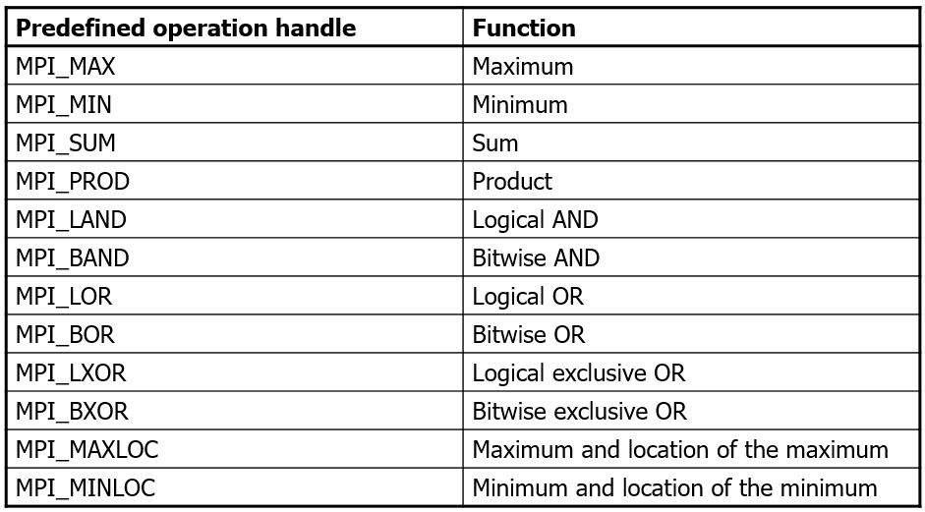
Reduction Operations
Reduction Operations:
Data types:
– Operations are defined for appropriate data types

Slide 31
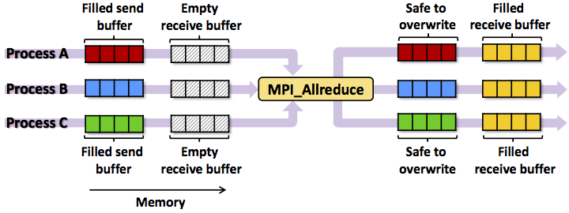
MPI_Allreduce
Similar to MPI_Reduce, returns the result value to all processes
Credits: https://dps.uibk.ac.at

Slide 32
Any Questions

